Slide 1
Exception Handling

Slide 2
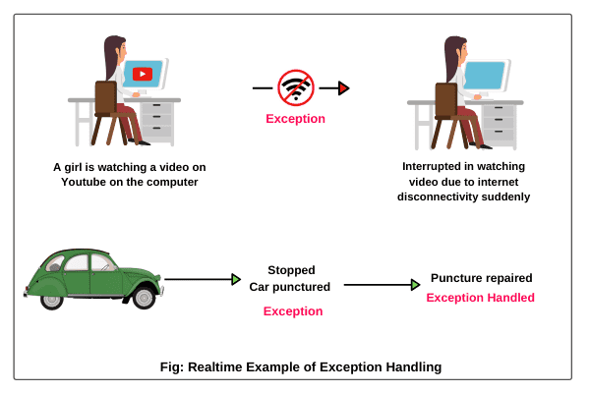
Introduction
An exception is a problem that arises during the execution of a program.
An exception can occur for many different reasons, including the following:
  A user has entered invalid data.
  A file that needs to be opened cannot be found.
  A network connection has been lost in the middle of communications, or the JVM has run out of memory.
Some of these exceptions are caused by user error, others by programmer error, & others by physical resources that have failed in some manner.

Slide 3
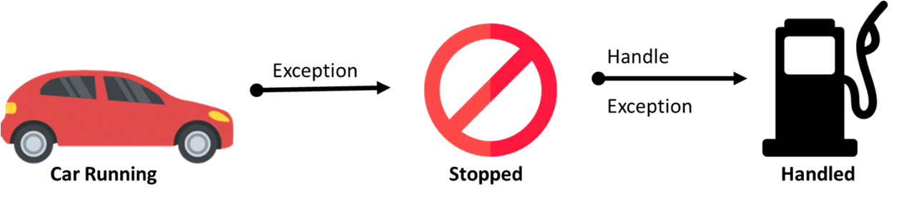
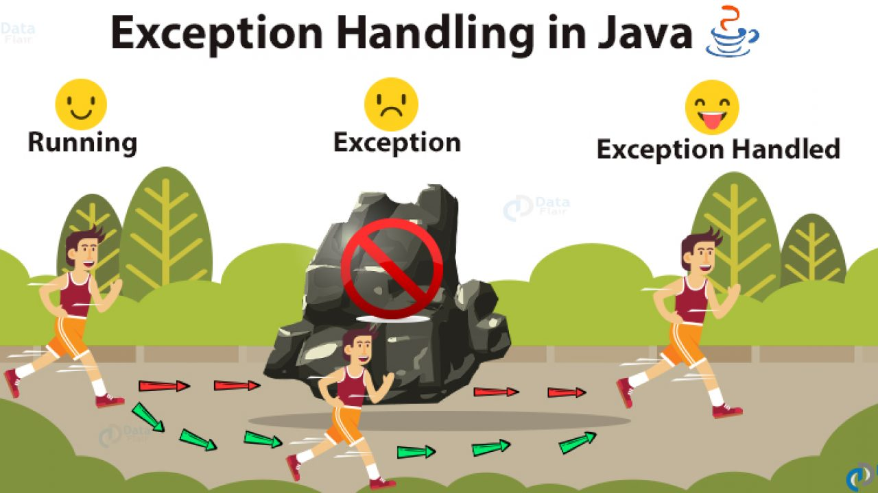
Introduction
Exception handling in java is a powerful mechanism or technique that allows us to handle runtime errors in a program so that the normal flow of the program can be maintained.

Slide 4
Exceptions categories
Errors: These are not exceptions at all, but problems that arise beyond the control of the user or the programmer. Errors are typically ignored in your code because you can rarely do anything about an error.
Example : Out of memory, Virtual Machine Error etc.

Slide 5
Exceptions categories
Checked exceptions: are those exceptions that are checked by the java compiler itself at compilation time. It is an exception that is typically a user error or a problem that cannot be foreseen by the programmer.
For example, if a file is to be opened, but the file cannot be found, an exception occurs. These exceptions cannot simply be ignored at the time of compilation.
Example : IOException, SQLException etc.

Slide 6
List of Checked Exceptions in Java
ClassNotFoundException: is thrown when we attempt to use a class that does not exist.
FileNotFoundException: is thrown when we attempt to access a non-existing file.
InterruptedException: is thrown when a thread is in sleeping or waiting state and another thread attempt to interrupt it.
InstantiationException: is thrown when we try to create an object of abstract class or interface.
IllegalAccessException: is thrown when a method is called in another method or class but the calling method or class does not have permission to access that method.
CloneNotSupportedException: is thrown when we try to clone an object without implementing the cloneable interface.
NoSuchFieldException: is thrown when an unknown variable is used.
NoSuchMethodException: is thrown when the undefined method is used.

Slide 7
Exceptions categories
Unchecked exceptions or Runtime exceptions: are those exceptions that are checked by JVM, not by java compiler. They occur during the runtime of a program that probably could have been avoided by the programmer.
Unchecked exception are not checked at the time of compile time rather they checked at runtime. We can write a program and compile it. But we cannot see the effect of unchecked exceptions and errors until we run the program.
Example : ArithmeticException, NumberFormatException etc.

Slide 8
List of Unchecked Exceptions in Java
ArithmeticException
ClassCastException
NullPointerException
ArrayIndexOutOfBoundsException
NegativeArraySizeException
ArrayStoreException
IllegalThreadStateException
SecurityException

Slide 9
Checked Exceptions
Unchecked Exceptions
Not inherit from RuntimeException.
Checked exceptions are checked at compile-time.
The program doesn't compile if there is an unhandled checked exception in the program code.
Example : IOException, SQLException, ClassNotFoundException
inherit from RuntimeException.
Unchecked exceptions are checked at run-time.
The program compiles successfully even if there is an unhandled unchecked exception in the program code.
Example : ArithmeticException, ClassCastException, NullPointerException

Slide 10
Exception Hierarchy
All exception classes are subtypes of the java.lang.Exception class. The exception class is a subclass of the Throwable class.
Other than the exception class there is another subclass called Error which is derived from the Throwable class.

Slide 11
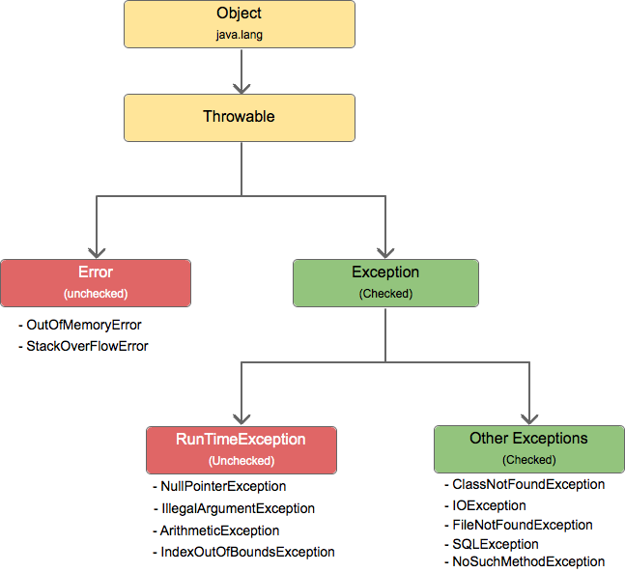
Introduction

Slide 12
Catching Exceptions
A block of code that catches the exception thrown by JVM is called exception handler.
This whole mechanism is called exception handling.
Java provides five essential keywords to handle an exception.
try
catch
finally
throw
throws

Slide 13
Catching Exceptions
A method catches an exception using a combination of the try & catch keywords.
A try/catch block is placed around the code that might generate an exception. Code within a try/catch block is referred to as protected code.
try block encloses the code that might throw an exception.
catch block is used to handle the exception. It must be used after try block.

Slide 14
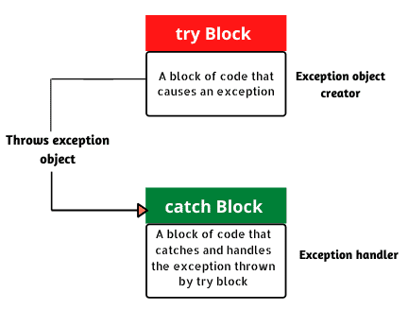
try
{
//Protected code
}
catch(ExceptionName e1)
{
//Catch block
}

Slide 15
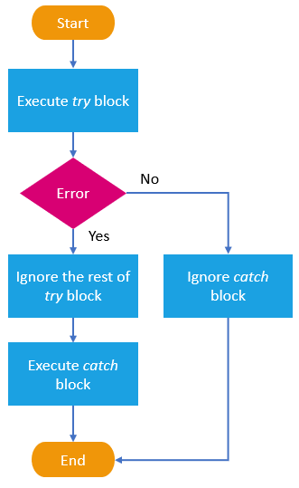

Slide 16
A catch statement involves declaring the type of exception you are trying to catch.
If an exception occurs in protected code, the catch block (or blocks) that follows the try is checked.
If the type of exception that occurred is listed in a catch block, the exception is passed to the catch block much as an argument is passed into a method parameter.

Slide 17
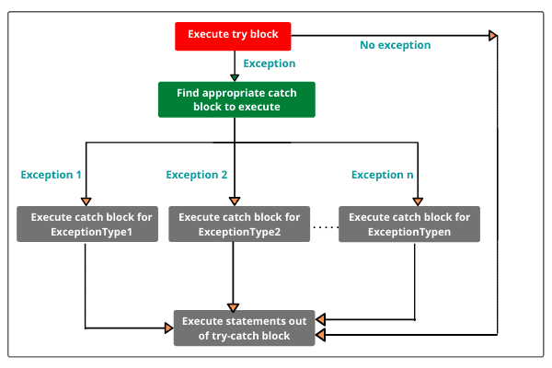
Multiple catch Blocks
try
{
//Protected code
}
catch(Exception1 e1)
{
//Catch block
}
catch(Exceptio2 e2)
{
//Catch block
}
catch(Exception3 e3)
{
//Catch block
}

Slide 18
The throws & throw Keywords
If a method does not handle a checked exception, the method must declare it using the throws keyword. The throws keyword appears at the end of a method's signature.
The throw keyword is used to explicitly throw an exception. The throw keyword is mainly used to throw user defined exception.

Slide 19
throw | throws
Java throw keyword is used to explicitly throw an exception. | Java throws keyword is used to declare an exception.
Checked exception cannot be propagated using throw only. | Checked exception can be propagated with throws.
Throw is followed by an instance. | Throws is followed by class.
Throw is used within the method. | Throws is used with the method signature.
You cannot throw multiple exceptions. | You can declare multiple exceptions e.g. public void method()throws IOException,SQLException.

Slide 20
Finally Block
A finally block of code always executes, whether or not an exception has occurred.
Using a finally block allows you to run any cleanup-type statements that you want to execute, no matter what happens in the protected code.
A finally block appears at the end of the catch blocks.
For each try block there can be zero or more catch blocks, but only one finally block.
When the System.exit() method is called in the try block before the execution of finally block, finally block will not be executed.

Slide 21
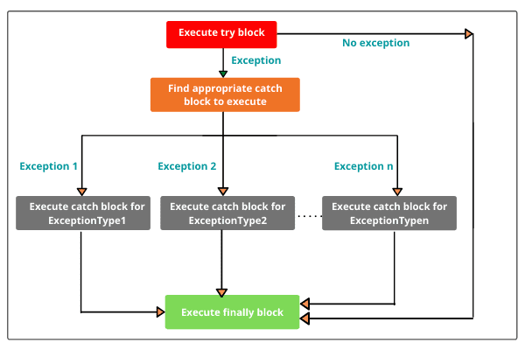

Slide 22
9130013411
Thank You

